Slide 1






Safe and Secured City
S
Storyboard Description: The focus of the storyboard will surround the topic of “safety” and “security” under the umbrella of SDG 11. The security index, number of prisoners and quality of road in some ASEAN countries is facing deleterious trend. Some of the feasible recommendations are proposed to tackle these issues, such as developing a “No Track Thanks” mobile application, Recidivism Reduction System, and RTI Portholes System.
Team Name | USM DSExplorer
Participants Name | Morris Lee Kah Win Soh Hong Say
Institution | Universiti Sains Malaysia (USM)
Represented Country | Malaysia

Slide 2
WHAT HAVE HAPPENED TO THE SAFETY ENVIRONMENT?
01 Kuala Lumpur Crime Index
01 Myanmar Protest
01 Cambodia
01
03
06
Kuala Lumpur, Malaysia in 2020
has the HIGHEST Crime Index in ASEAN Countries, and 4th highest in Asia.
Crime Index = 57.89
(Numbeo, 2021)
As of 23 May 2021 in the 2021 Myanmar Protest, 818 protesters have been killed
(AAPP, 2021)
Cambodia has a high increment of crimes in the past 3 years. Crime Increased Index = 65.99
(Numbeo, 2021)
01 Thailand Protest
04
Around 50,000 people attended 19 Sep 2020 rally amid Covid-19 Outbreak
(TheGuardian, 2020)
01 Covid-19
02
As of 5 June 2021,
4,126,790 Confirmed Cases
80,781 deaths in ASEAN Countries
(WHO, 2021)
01 Lockdown
05
8 out of 10 ASEAN Countries have implemented lockdown due to Covid-19 (WHO, 2021)
2

Slide 3
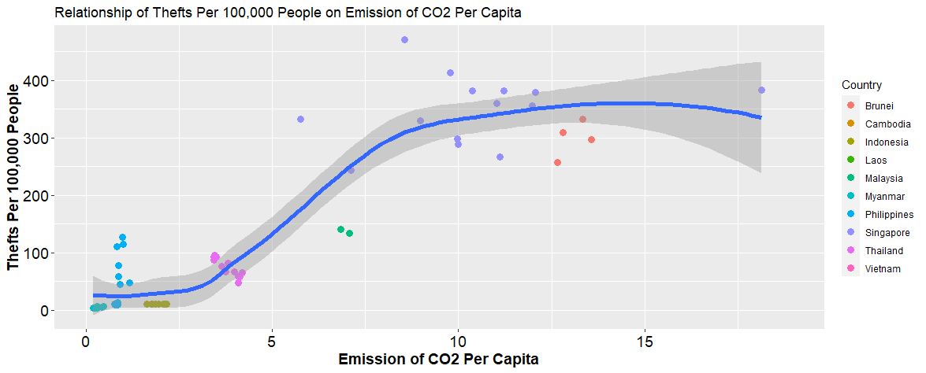
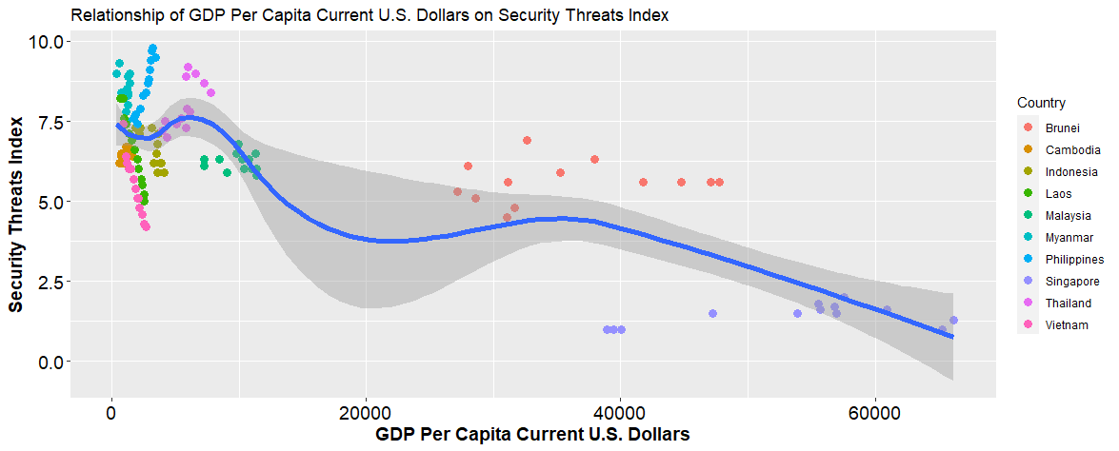




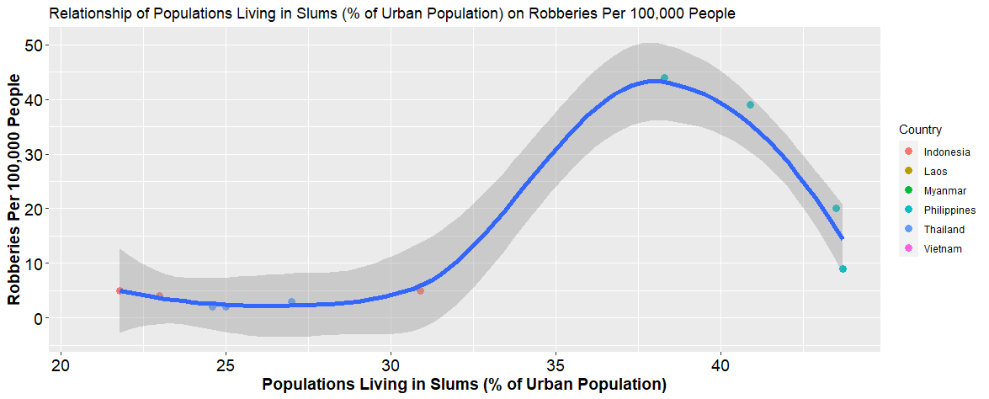


PREDICTORS TOWARD SAFETY AND SECURITY ATTRIBUTES
01 Correlation = +0.90
01 Correlation = -0.75
01
02
(Our World in Data, 2020; TheGlobalEconomy, 2021)
(TheGlobalEconomy, 2021)
Emissions of co2 per capita has a very high positive correlation to number of thefts.
GDP per capita has a high negative correlation to security threats.
01 Correlation = +0.67
03
Populations living in slums (% of urban population) has a positive correlation to number of robberies.
3
(World Bank, 2021; TheGlobalEconomy, 2021)

Slide 4
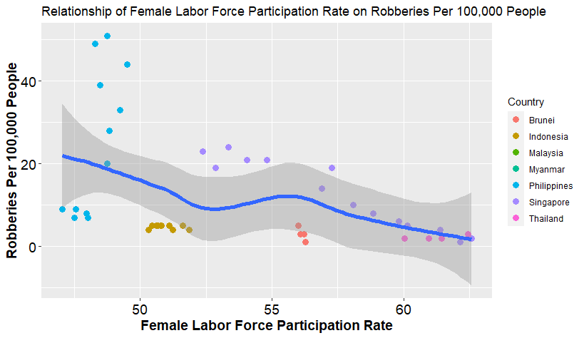

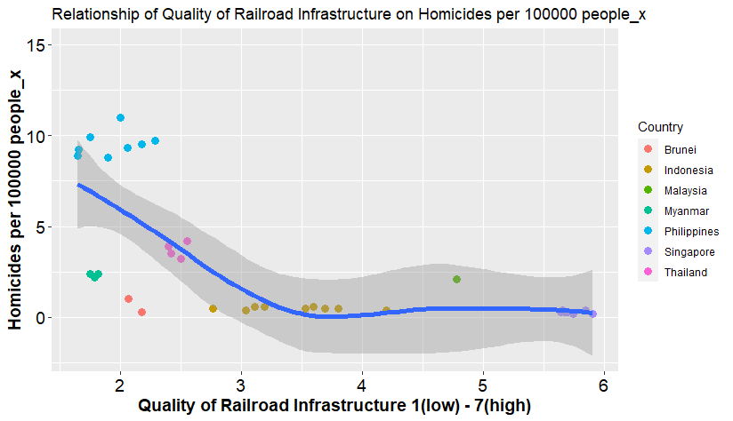


01 Correlation = -0.56
04
Female labor force participation rate has a negative correlation to number of robberies.
(TheGlobalEconomy, 2021)
01 Correlation = -0.57
05
Quality of railroad infrastructure has a negative correlation to Homicides.
(TheGlobalEconomy, 2021)
4
01 Reduce emission of CO2 in the environment to reduce number of thefts.
02 Increase GDP Per Capita in ASEAN Countries to reduce the security threats.
03 Reduce populations living in slum to reduce the number of robberies.
04 Increase female labor force participation rate to reduce the number of robberies.
05 Increase the quality of railroad infrastructure to reduce the number of homicides.

Slide 5
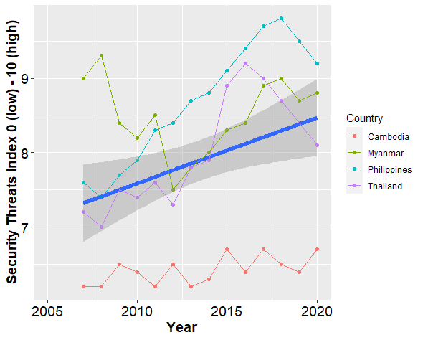
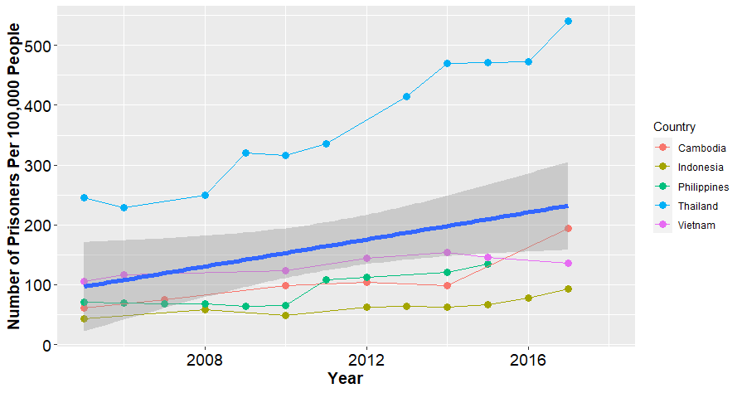
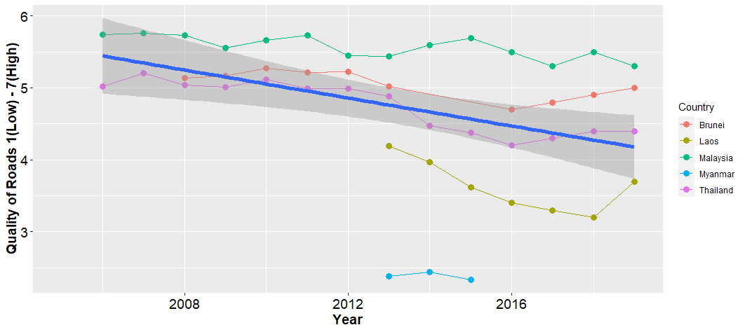
PROBLEM ANALYSIS IN ASEAN COUNTRIES
01 Security Threats Index
Key Insight Takeaway
01
01 Cambodia, Myanmar, Philippines and Thailand have upward trend for Security Threats Index.
02 Cambodia, Indonesia, Philippines, Thailand and Vietnam have upward trend for Prisoners Per 100,000 People over the year.
03 Brunei, Laos, Malaysia, Myanmar and Thailand have a downward trend of Quality of Roads over the year, which make the transportation route less safe.
(TheGlobalEconomy, 2021)
01 Prisoners Per 100,000 People
01 Quality of Roads
02
03
(TheGlobalEconomy, 2021)
(TheGlobalEconomy, 2021)
5

Slide 6
PROBLEM STATEMENT AND DECLARATION
01 Security Threats Index
SDG To Achieve
01
G
G
Problem Statement 1: Cambodia, Myanmar, Philippines and Thailand have upward trend for Security Threats Index from 2007 to 2020 amounted to 1.09%.
SDG 11: Make cities and human settlements inclusive, safe, resilient and sustainable. The particular SDG to achieve are:
SDG11.2 By 2030, provide access to safe, affordable, accessible and sustainable transport systems for all (View More).
and SDG11.7 By 2030, provide universal access to safe, inclusive and accessible, green and public spaces (View More).
01 Prisoners per 100,000 People
Socio Cultural
02
G
This storyboard is going to achieve in the ASEAN Socio-Cultural Community Blueprint 2025 are:
B.2. Equitable Access for All (viii.) Prevent them from falling
under the negative influence of violent extremism and threats (View More).
D. Resilient 18 Fully embracing the principles of comprehensive security (View More).
Problem Statement 2: Cambodia, Indonesia, Philippines, Thailand and Vietnam have upward trend (increased 1.6%) for Prisoners Per 100,000 People from 2004 to 2017.
01 Quality of Road
Economic
03
G
This storyboard is going to achieve in the ASEAN Economic Community Blueprint 2025 are:
A.4.17 Robust financial market infrastructure that is safe, cost-efficient, and more connected (View More).
C.1.48.i Safe and integrated regional land transport network (View More).
C.6.59.ii Ensure safety and security, prioritising protection (View More).
Problem Statement 3: Brunei, Laos, Malaysia, Myanmar and Thailand have a downward trend of Quality of Roads over the year from 2006 to 2019 amounted to 0.23%.
6

Slide 7
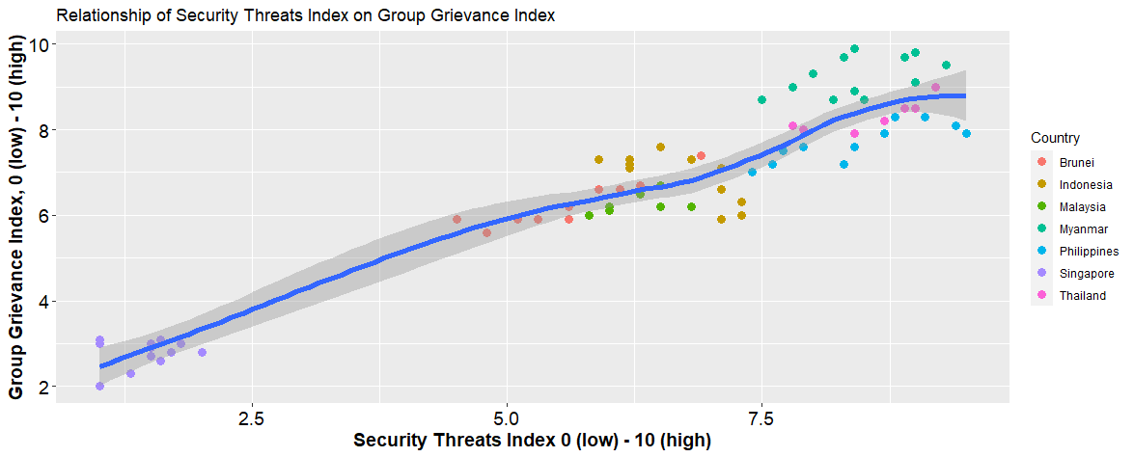

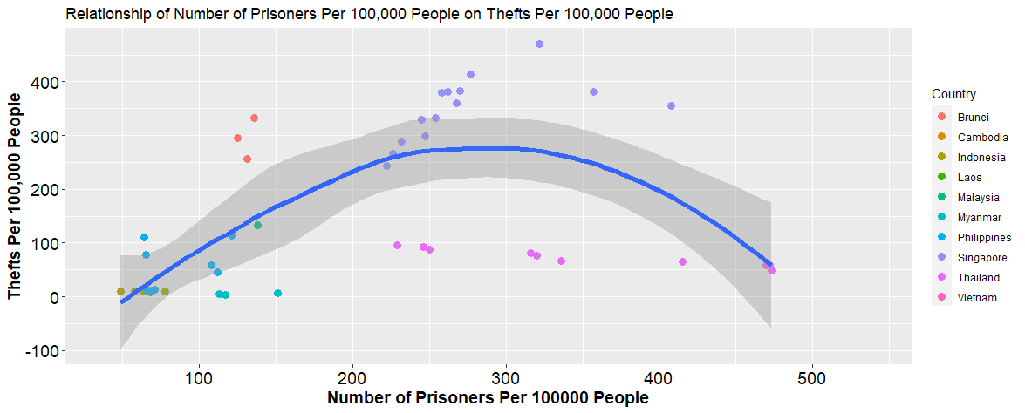

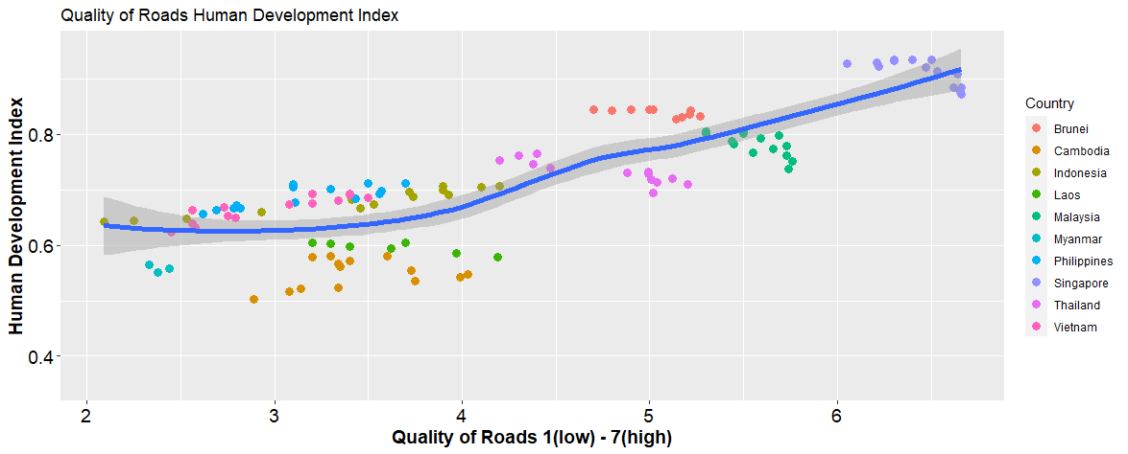


01 Implication of the Problem Statement 1
01
Security Threats Index has a very high positive correlation (0.90) to Group Grievance Index.
(TheGlobalEconomy, 2021)
01 Implication of the Problem Statement 2
02
Number of Prisoners has a positive correlation (0.41) to number of thefts.
(TheGlobalEconomy, 2021)
01 Implication of the Problem Statement 1
03
Quality of Roads has a very high positive correlation (0.83) to Human Development Index.
7
(TheGlobalEconomy, 2021)

Slide 8










RECOMMENDATION
01 Build a Security App - No Track Thanks
01
Manage App
Manage All
Summary
Manage App
Manage All
Summary
Manage App
Manage All
Summary
App Icon
Manage App Tracking
Allow sharing your IP address with all the apps?
Allow sharing?
Location
Contacts
Photo
Allow sharing your photos with all the apps?
“No Track Thanks” which is a firewall mobile app to stop the connections from identified trackers, malware and even ransomware. It provides functions such as allowing users to unshared locations, contacts, photos from selected apps or by manage all apps at once. It also provide a summary to inform users about the once hidden trackers in the apps and games
Allow sharing your contacts with all apps?
High risk apps detected as follow:
View The Tracking Log Summary
Uninstall Block tracking connection
To manage app one by one
To manage all apps at once
To view summary
According to (INTERPOL Global Complex for Innovation, 2021), malware and ransomware is a significant threat in the ASEAN region. Therefore the app is proposed to be free download and used by all ASEAN countries citizen and the app will be audited by accountant for not having security issue.
Implication: Mitigate the Security Threat Index that can be easily scalable to several ASEAN countries.
8

Slide 9



RECOMMENDATION
01 Break the Cycle of Reoffending (Recidivism Reduction System)
02
Track for 2 years
Breaking the Cycle
Jail
New Circle of Friends
Vocational Training
Job Opportunity
Big Data Analysis for HR Matching
RTI Portholes System
New Financial opportunity
Provided by Recommendation 3
To identify portholes at the road
Job Matching
Combine training with market needs
Change thinking and attitude
Research has shown that training and education can successfully reduce recidivism rates (Mohammed & Mohamed, 2015). After prisoners released from jail, government can collaborate with universities and schools to provide vocational training for them to learn new skills, (such as cooking, wiring, plumbing and etc.), and meet new circle of friends to ensure they are connected with the society. They can join RTI Portholes Identifier (Recommendation 3) to earn a livelihood as this job not require any background of academic as proposed in recommendation. Besides, police need to track the newly released prisoners for 2 years ensure they are not reoffending. Based on this solution, the recidivism rate and number of prisoners are very likely to be mitigated.
9

Slide 10





RECOMMENDATION
01 RTI Potholes System
03
A website will be build for Real Time Information (RTI) Potholes System.
Whenever citizen identify potholes, they can capture a photo and send location via GPS to the website.
After a data analyst to analyze the road conditions, available resources, location and etc., an optimal solutions will be recommended.
Then, a construction worker nearby will be contacted to fill up the potholes.
The citizen and construction worker will obtain incentive when the potholes have been resolved.
information
data
Data Centre
Government Agent
Cell Centre
Incentive
Incentive
GPS and data
Satellite
GPS and data
repair
Citizen Identify potholes
Construction Worker
Implication 1: The RTI website can be shared by all ASEAN countries.
Implication 2: Quality of Road Index can be improved on all ASEAN countries, particularly for the countries having downward trend of Quality of Road Index.
10

Slide 11
Referencing
AAPP, Assistance Association For Political Prisoners (Burma) (2021). Retrieved June 6, 2021, from https://aappb.org/.
INTERPOL Global Complex for Innovation. (2021). ASEAN Cyberthreat Assessment. https://www.i nterpol.int/content/download/16106/file/ASEAN%20Cyberthreat%20Assessment%202021%20-%20final.pdf.
Freepik, Graphic resources for everyone (n.d.). Retrieved June 6, 2021, from https://www.freepik.com/.
Mohammed, H., & Mohamed, W. A. W. (2015). Reducing recidivism rates through vocational education and training. Procedia-Social and Behavioral Sciences, 204, 272-276.
Numbeo, Asia: Crime Index by City 2020 (n.d.). Retrieved June 6, 2021, from https://www.numbeo.com/crime/region_rankings.jsp?title=2020&region=142.
Numbeo, Crime in Cambodia (n.d.). Retrieved June 6, 2021, from https://www.numbeo.com/crime/country_result.jsp?country=Cambodia.
Our World In Data, CO₂ and Greenhouse Gas Emissions. (2020). Retrieved June 6, 2021, from https://ourworldindata.org/co2-and-other-greenhouse-gas-emissions.
TheGuardian (2020), Thousands gather in Thailand for anti-government protest. Retrieved June 20, 2021, from https://www.theguardian.com/world/2020/sep/19/thousands-gather-in-thailand-for-anti-government-protest-Bangkok.
TheGlobalEconomy(2021). Retrieved June 6, 2021, from https://www.theglobaleconomy.com/download-data.php.
World Bank, Population living in slums (% of urban population). (2020). Retrieved June 6, 2021, from https://data.worldbank.org/indicator/EN.POP.SLUM.UR.ZS.
World Health Organization, WHO Coronavirus (COVID-19) Dashboard (2021). Retrieved June 6, 2021, from https://covid19.who.int/.

